Slide 1

INBO WORLD BASIN SUMMIT 2026
Uma nova perspetiva sobre a segurança hídrica na Namíbia
O papel dos sistemas hidrográficos no abastecimento de água nas zonas urbanas e rurais
Maria Amakali
Ministry of Agriculture, Fisheries, Water and Land Reform
Namibia

Slide 2
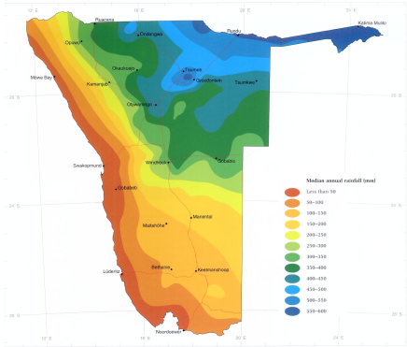
O IMPERATIVO HIDROGEOLÓGICO
Fatores fundamentais de escassez
A Namíbia está entre os países com maior escassez de água a nível mundial.
Variabilidade da precipitação: Quase nula (na costa) a 600 mm (em direção ao nordeste).
As taxas de evaporação reduzem drasticamente a eficiência do armazenamento à superfície ao ar livre.
National Water Metric | Statistics and Targets
Total de água doce renovável | 600 million m^3/a
2030 Demand Projection | 772 million m^3/a
Cobertura do acesso à água nas zonas urbanas | 99%
Cobertura do acesso à água nas zonas rurais | 87% (Target 95% by 2022)
Valor da Infraestrutura Nacional | N$ 10.82 billion (planned 5-7 years)
NATIONAL WATER METRICS & TARGETS
Notes:
Namibia population is 3,030,000

Slide 3






QUADRO DE GOVERNAÇÃO INTEGRADA
Viragem legislativa
A Unidade da Bacia
BMCs
Transição da Lei da Água de 1956 para a Lei de Gestão de 2013 (que entrou plenamente em vigor em agosto de 2023).
A unidade de gestão principal passou a ser as bacias hidrográficas, transferindo o poder de decisão para as partes interessadas.
As Comissões de Gestão das Bacias Hidrográficas facilitam a repartição equitativa dos recursos e a monitorização da poluição.
IWRM

Slide 4
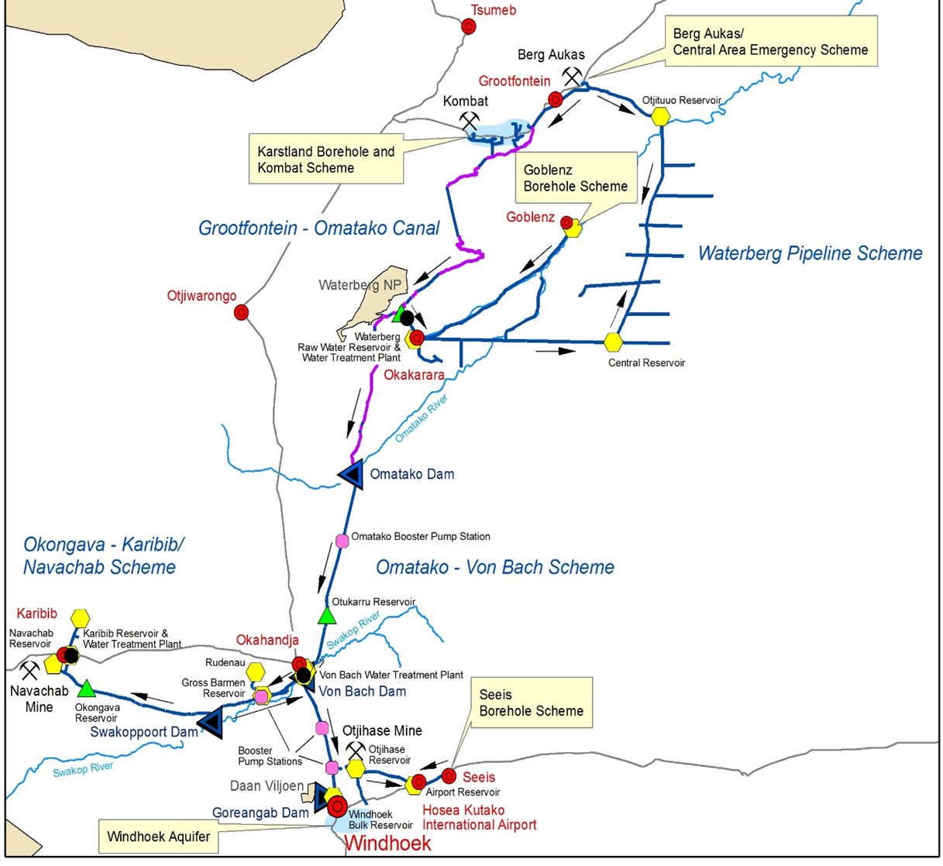
UPPER SWAKOP: RESILIÊNCIA DO ABASTECIMENTO URBANO
Uma tábua de salvação para a capital
A segurança de Windhoek assenta no seu papel de «cidade ligada a uma bacia hidrográfica», que gere uma combinação de recursos de alto risco.
Barragem de Von Bach: principal centro de abastecimento das terras altas centrais. (3 sistemas de barragens)
Vulnerability: Levels fell to 12.6% in early 2024.
Aumento: Transferências da Bacia Cárstica de Tsumeb ao longo de centenas de quilómetros.

Slide 5
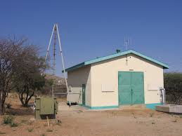
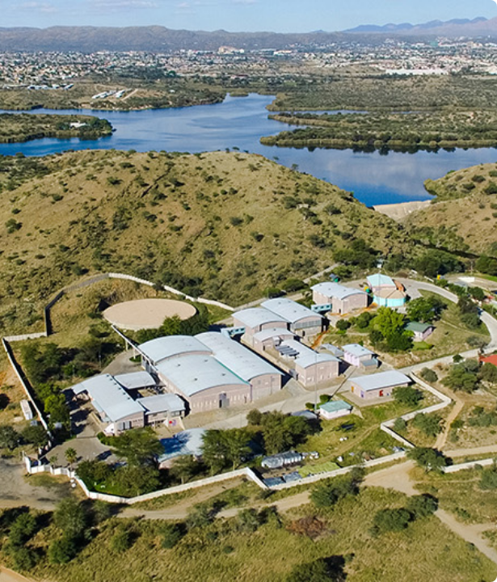
TECHNOLOGICAL INNOVATION
Direct Potable Reclamation (DPR)
Windhoek established the world's first DPR plant in 1968. The current facility provides 25% of urban supply.
Managed Aquifer Recharge (Mar)
Multi-Barrier Purification:
Strategic "Water Banking"
The Windhoek Managed Aquifer Recharge Scheme (WMARS) minimizes evaporation by injecting treated surface water into the ground.
1. Pre-ozonation & Coagulation
2. Dissolved Air Flotation (DAF)
3. Dual Media Filtration
4. Main Ozonation & BAC/GAC
480m³/h
5. Ultrafiltration (Physical Barrier)
Current managed recharge installed capacity
Notes:
Safety Nets.

Slide 6


ADAPTIVE GOVERNANCE CYCLE
The Central Area of Namibia (CAN) Workshop Model
A science-based three-year horizon assessment for risk mitigation.
Assessment
Stakeholder Sync
Action Plan
Review
Hydrological analysis of dam inflows post-rainy season.
Regional & local authorities align on allocation strategies.
IB-transfer, Activation of MAR injection (2.5M ) and DPR targets.
Periodic reassessment (e.g. May 2026) for demand management.

Slide 7
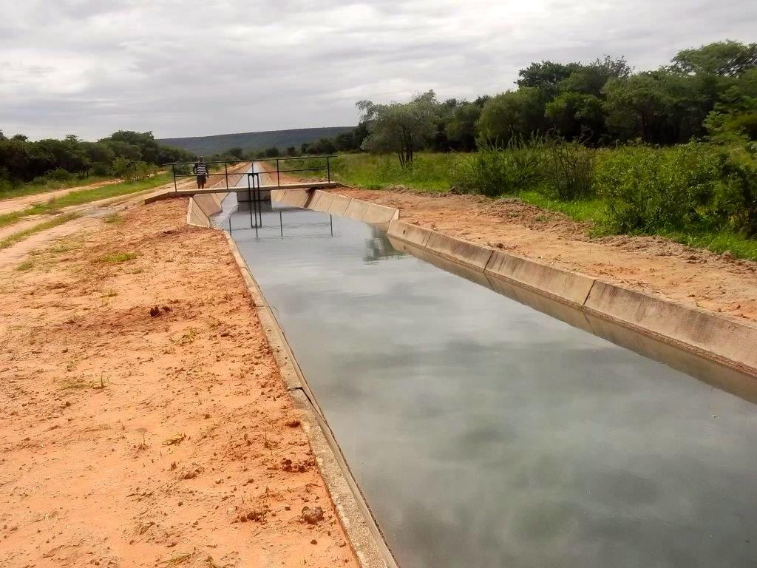
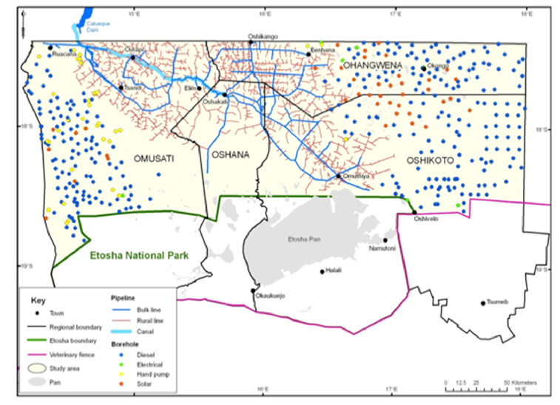
THE KUNENE RIVER: TRANSBOUNDARY SYNERGY
Transboundary water cooperation
Shared between Namibia and Angola, managed via the Permanent Joint Technical Commission (PJTC).
•
Strategic Supply: 154-km canal supplies the northern regions (Oshana, Omusati, etc.).
•
Calueque Dam: Landmark transboundary project for regional security – water use agreement.
•
The Pipeline Debate: Balancing evaporation loss reduction vs. rural livestock access.

Slide 8
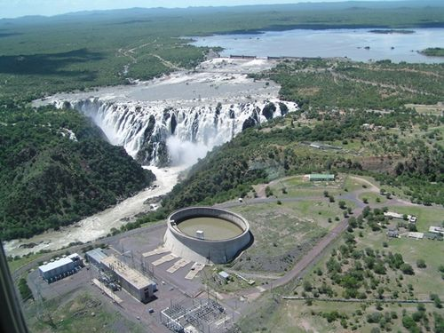

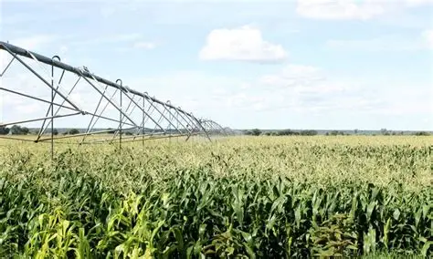

THE WATER-ENERGY-FOOD (WEF) NEXUS
Water + Energy
Ruacana (240 MW) provides 40% of national power; highly sensitive to basin hydrology.
Water + Food
Etunda Green Scheme relies on stable flows for food production

Slide 9
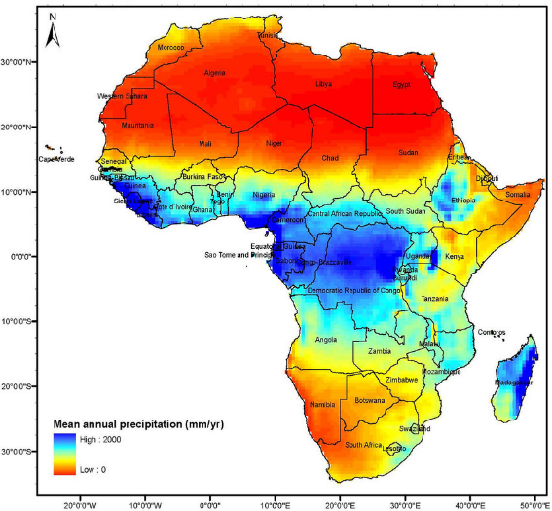
KEY MESSAGES
- Sustainable water security is fundamentally dependent on active participation and collaboration both within and across international borders.
- There is an urgent need to reinforce multi-level governance frameworks to manage shared water resources effectively and equitably.
- Water security strategies must be "risk-informed," ensuring that planning accounts for climate variability and potential resource scarcity.
- Resilient and inclusive development requires a holistic approach that integrates infrastructure development, resource management, and governance at the basin level.

